Slide 1
Using Bi-directional Long Short-Term Memory Recurrent Neural Network (Bi-LSTM RNN) to predict Elderly fall
Tai-Jung Chen

Slide 2
Outline
Background and Objectives
Data Description
Modeling
Preliminary Results
Future Works
References

Slide 3
Background and Objectives

Slide 4
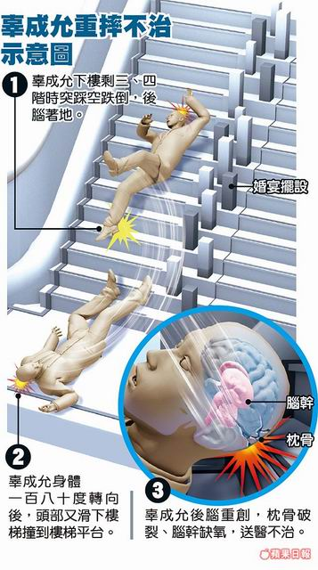
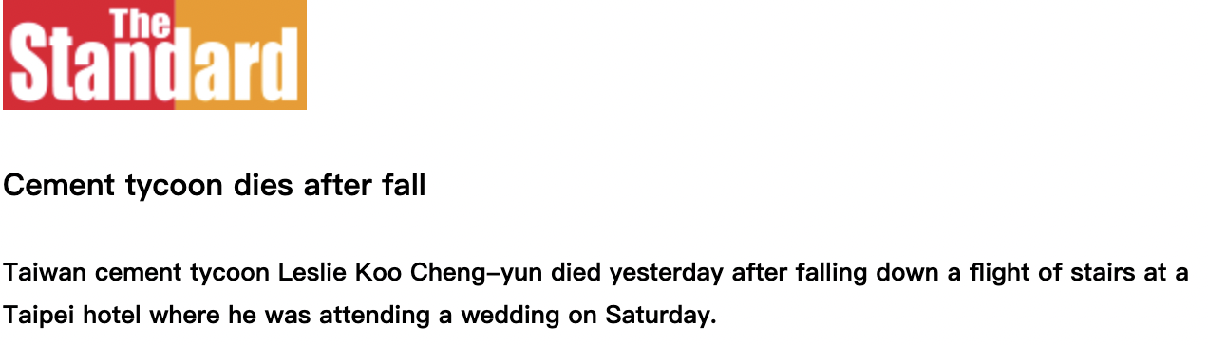
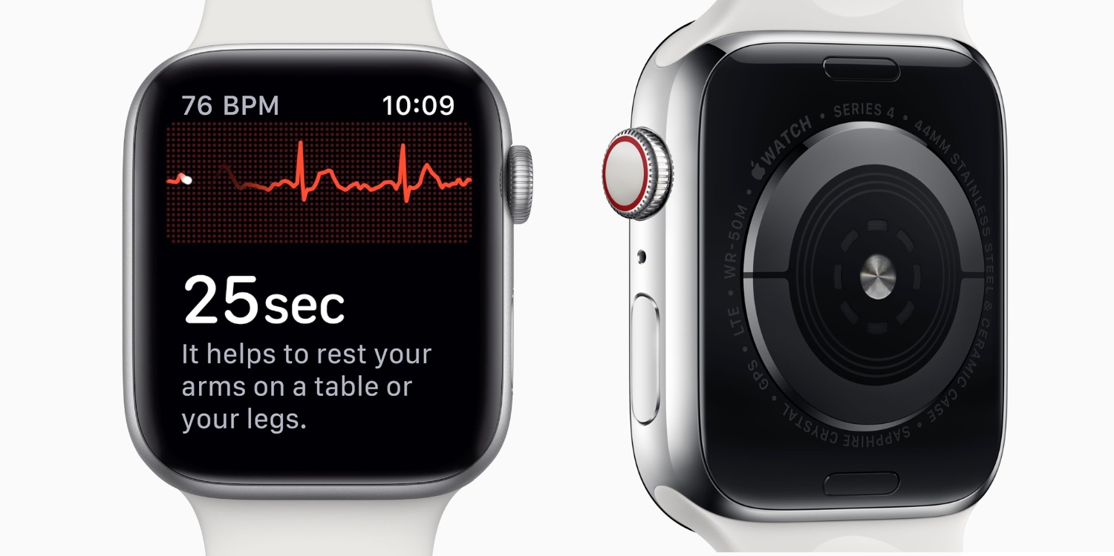
Background
Falling poses fatal threats for elderly people
Higher chance to result in bone, joint, muscle injuries
Higher chance of death
Falling frequency increases along with aging
30~60% of the community-dwelling elderly in the U.S fall each year
More than 50% of them experience multiple falls
Higher popularity and availability of wearable devises make data available for us to utilize
Apple watch, Fitbit
Community-dwelling elderly: individuals who were aged 65 and older living outside of nursing homes.
Notes:
62 years old

Slide 5
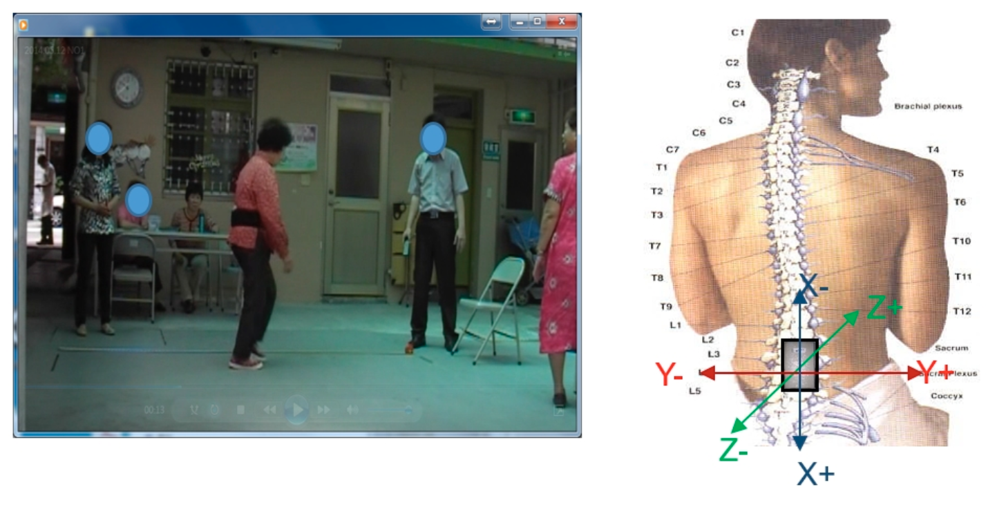
How do we collect the fall data?
Recruit elderly people and ask them to perform fall
Pros: Straightforward data source
Cons: Dangerous, and fake in a sense
Recruit elderly people to perform fall assessment test and evaluate their fall risk
Pros: Not dangerous
Cons: Correlated data source

Slide 6
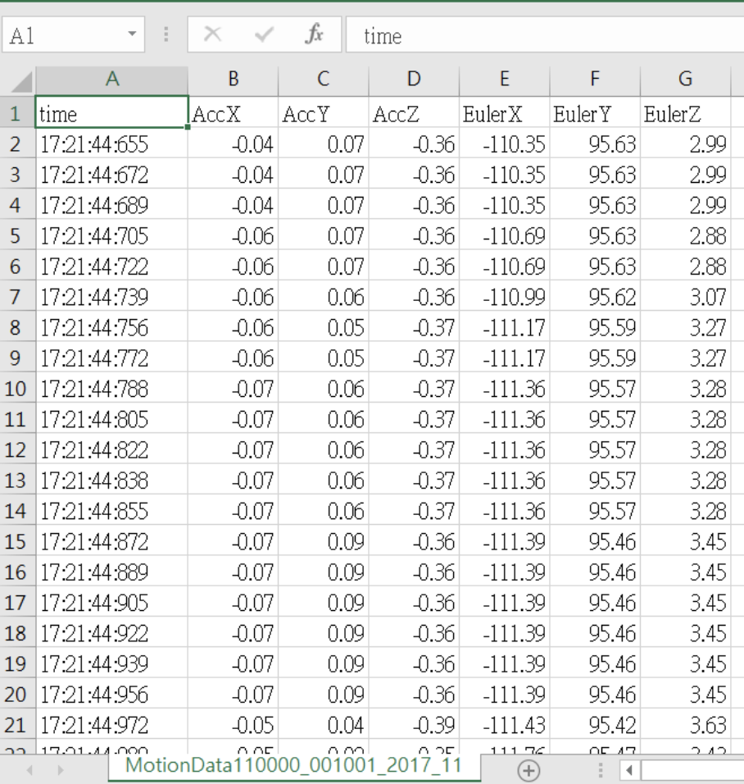
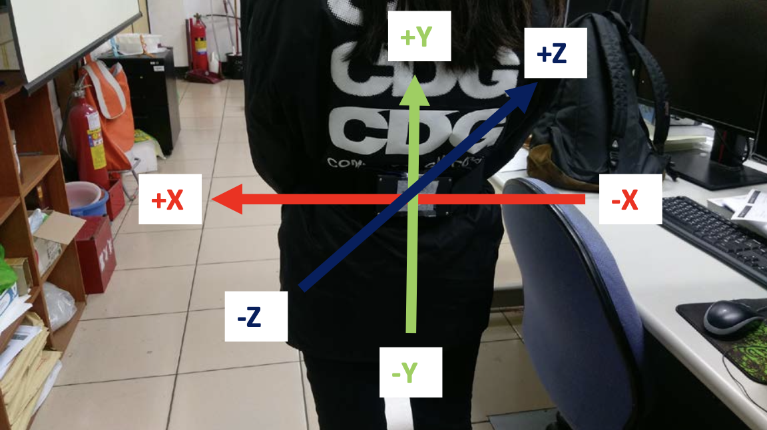
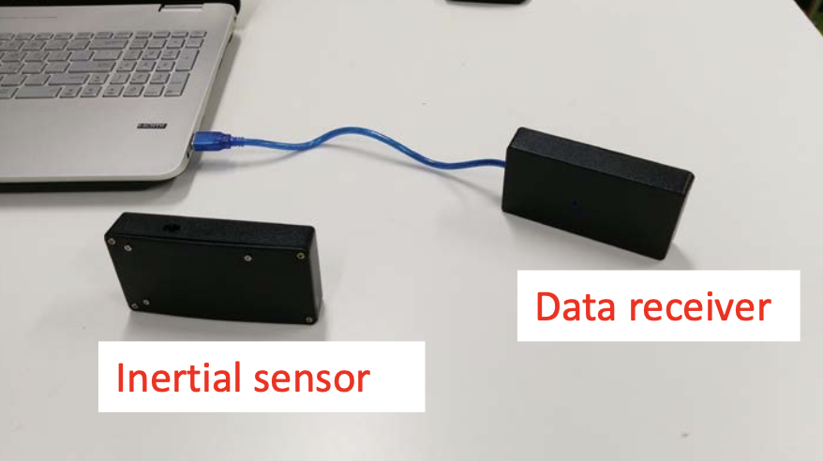
The sensor system
Acceleration
Angular speed

Slide 7
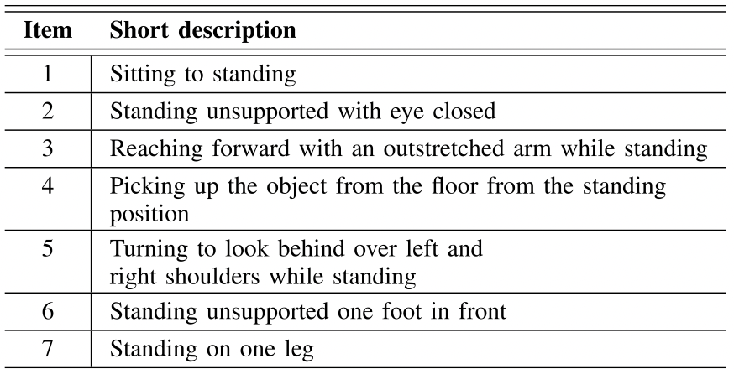
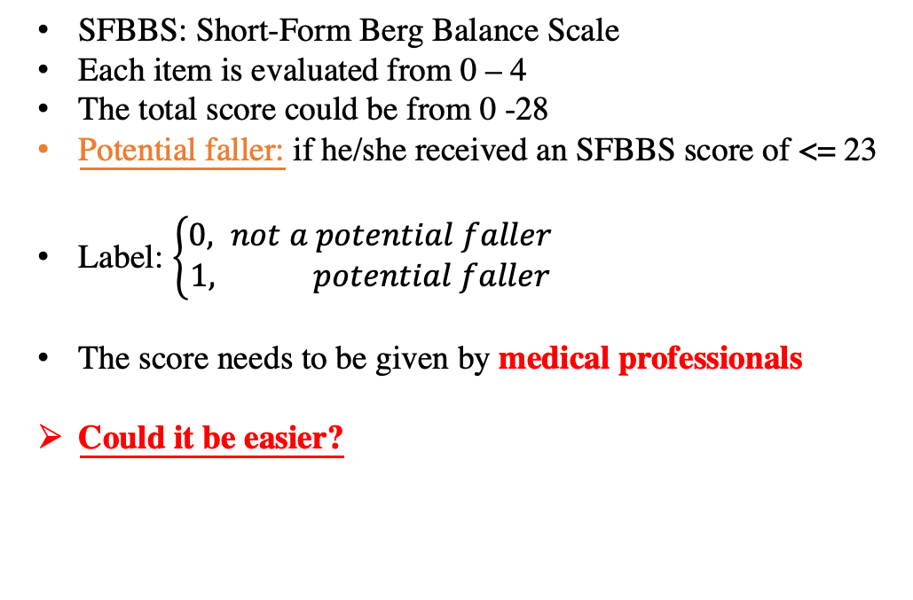
Fall Risk Assessment¹ – SFBBS
SFBBS: Short-Form Berg Balance Scale
Each item is evaluated from 0 – 4
The total score could be from 0 -28
Potential faller: if he/she received an SFBBS score of <= 23
Label: $\left\{\begin{aligned}0, not a potential faller \\ 1, potential faller\end{aligned}\right.$
The score needs to be given by medical professionals
Could it be easier?
Assessing Elderly’s Functional Balance and Mobility via Analyzing Data from Waist-mounted Tri-axial Wearable Accelerometers in Timed Up and Go Tests

Slide 8
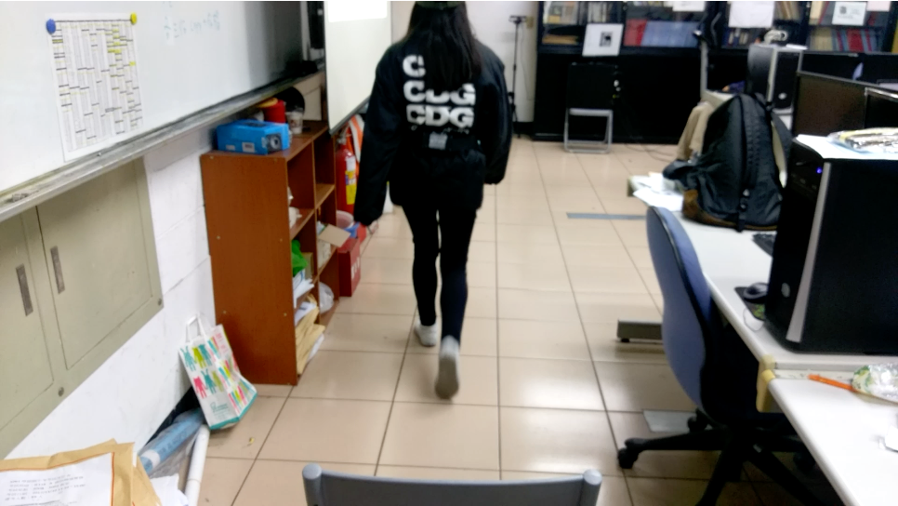
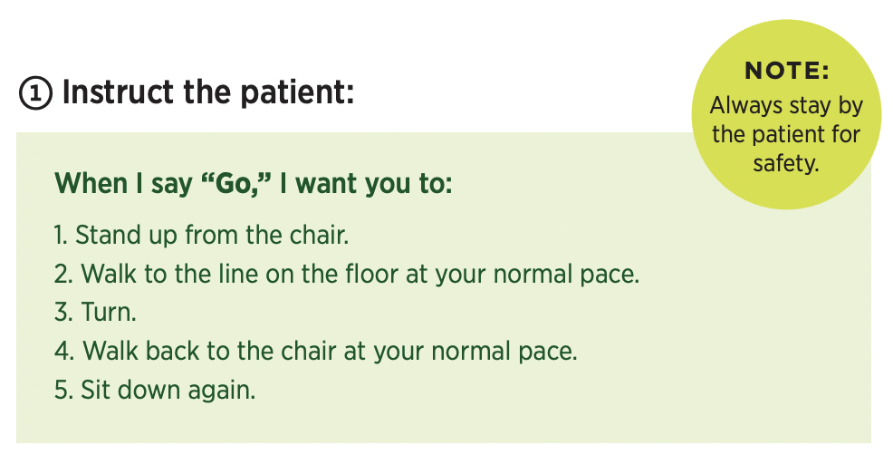
Fall Risk Assessment² – TUG test
https://www.cdc.gov/steadi/pdf/TUG_test-print.pdf
TUG: Timed Up and Go
The measured outcome is the patient’s test completion time. (> 13.5 secs is considered high fall risk)
This test allows non-medical professionals to roughly screening patients for fall risk

Slide 9

Objective
SFBBS
Fall risk assessment
Collect TUG test signal via sensors
Model
Develop predictive models that could:
Assist the medical professionals to evaluate fall risk
Alleviate the burden of the medical professionals

Slide 10
Data Description

Slide 11
Experiment Framework
Take the evaluation outcome to serve as the label
TUG test
SFBBS
Use sensor to record the signal

Slide 12
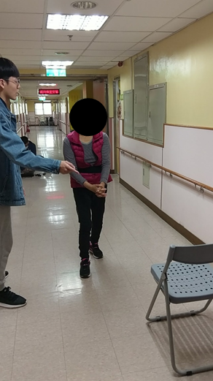
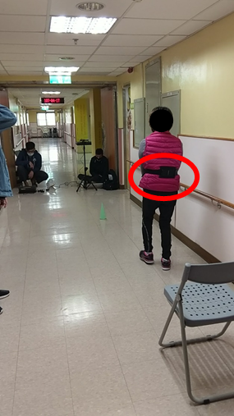
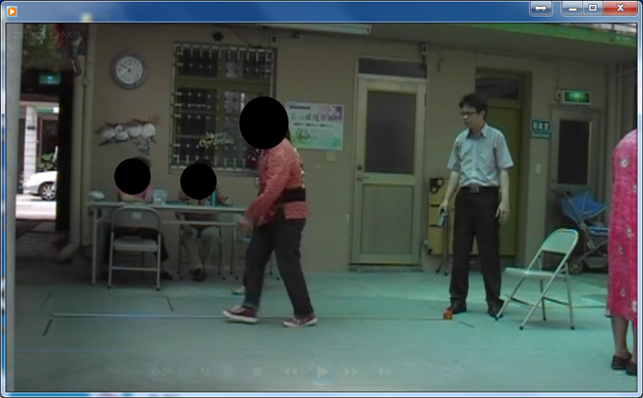
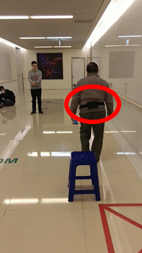
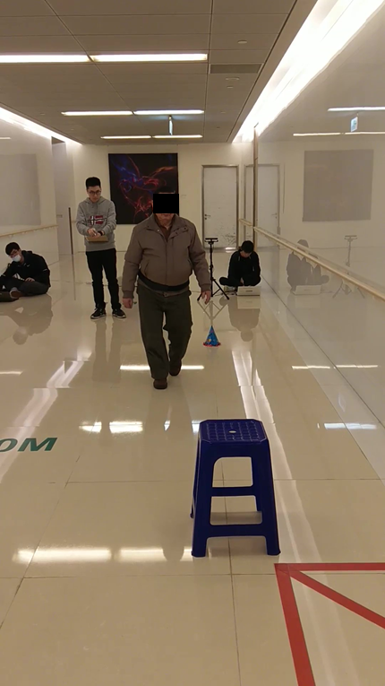
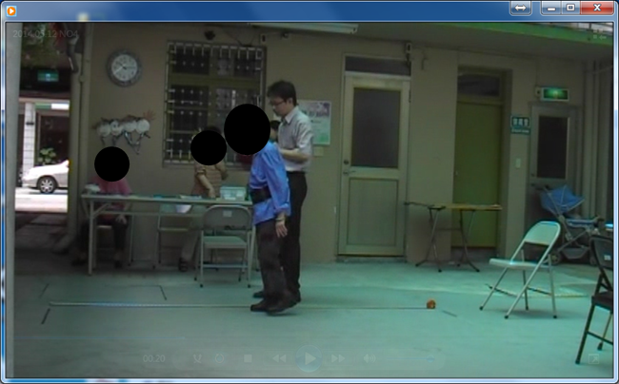
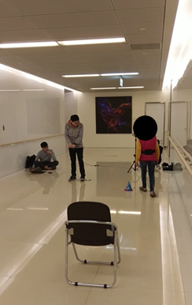
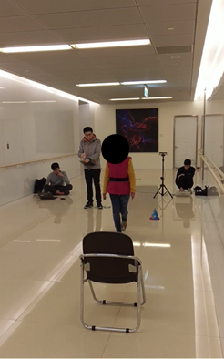
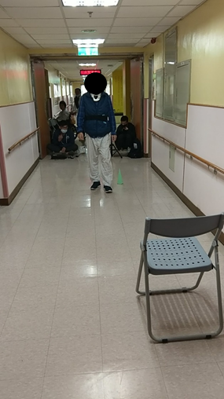
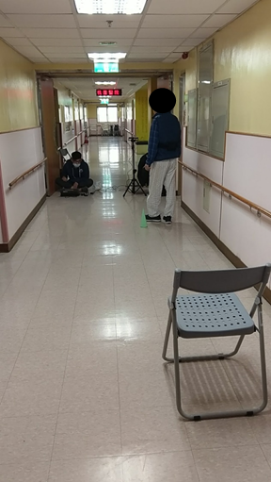
Available Datasets
Feng-Yuan Hospital
Elderly people
(2014-2015)
Far Eastern Memorial Hospital
Pulmonary disease elderly patients
(2017- )
Taoyuan Hospital
Stroke elderly patients
(2018- )

Slide 13
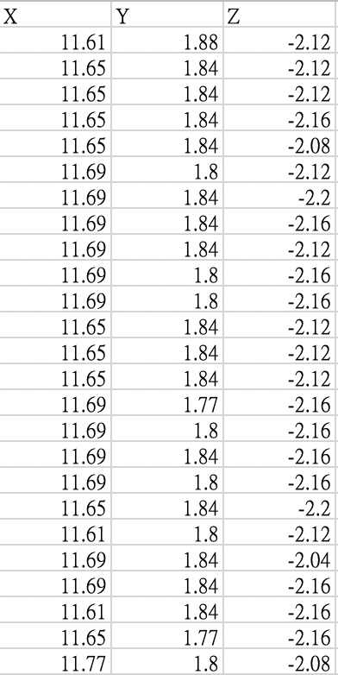
The Feng-Yuan Hospital dataset
Acceleration
Number of subjects: 150
General elderly people
Number of labels
Potential Faller (SFBBS <= 23) | 30
Non-potential Faller (SFBBS > 23) | 120

Slide 14
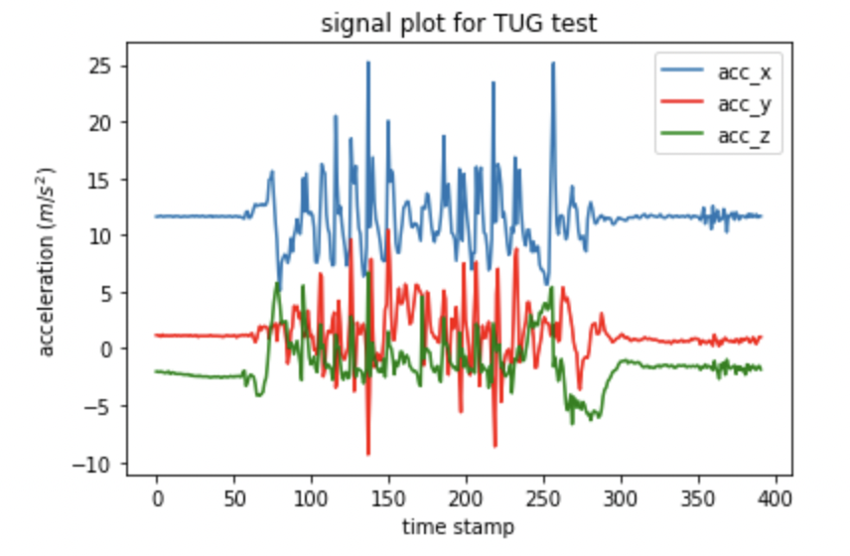
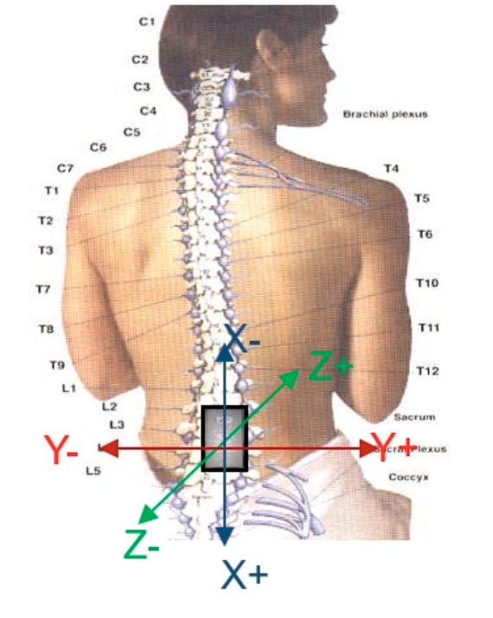
Acceleration Signal

Slide 15
Modeling

Slide 16
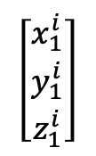
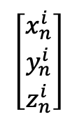
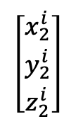
Pure data-driven model
$$\left[\begin{aligned}x_{1}^{i} \\ y_{1}^{i} \\ z_{1}^{i}\end{aligned}\right]$$
$$\left[\begin{aligned}x_{2}^{i} \\ y_{2}^{i} \\ z_{2}^{i}\end{aligned}\right]$$
$$\left[\begin{aligned}x_{n}^{i} \\ y_{n}^{i} \\ z_{n}^{i}\end{aligned}\right]$$
……
Subject i

Slide 17
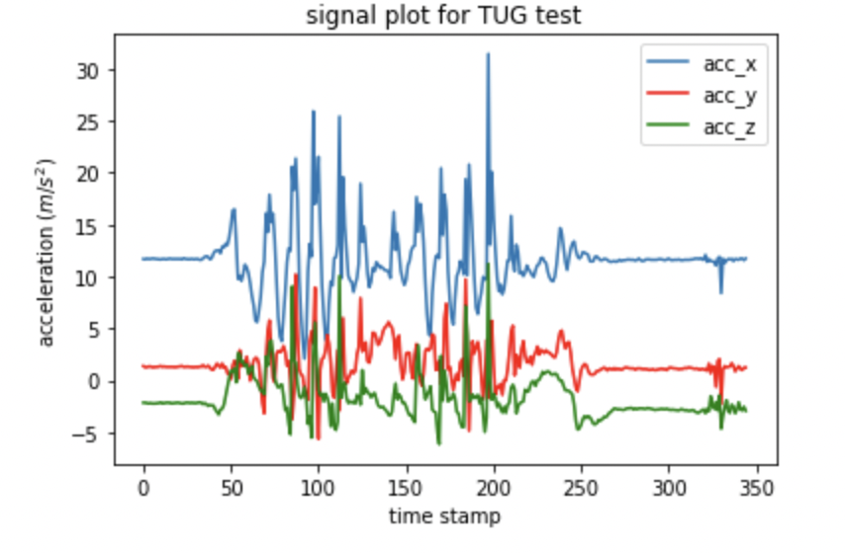
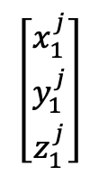
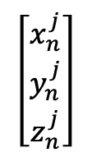
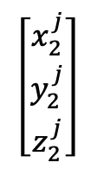
Pure data-driven model
$$\left[\begin{aligned}x_{1}^{j} \\ y_{1}^{j} \\ z_{1}^{j}\end{aligned}\right]$$
$$\left[\begin{aligned}x_{2}^{j} \\ y_{2}^{j} \\ z_{2}^{j}\end{aligned}\right]$$
$$\left[\begin{aligned}x_{n}^{j} \\ y_{n}^{j} \\ z_{n}^{j}\end{aligned}\right]$$
……
Subject j

Slide 18
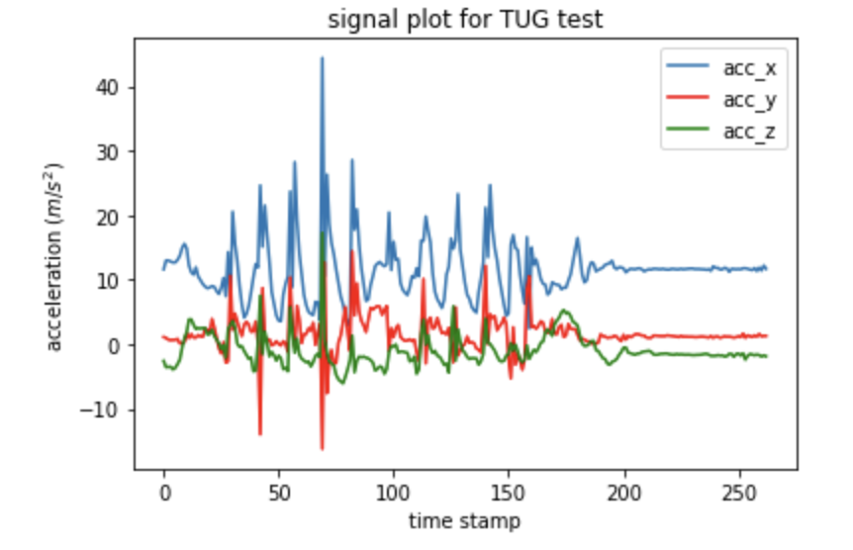
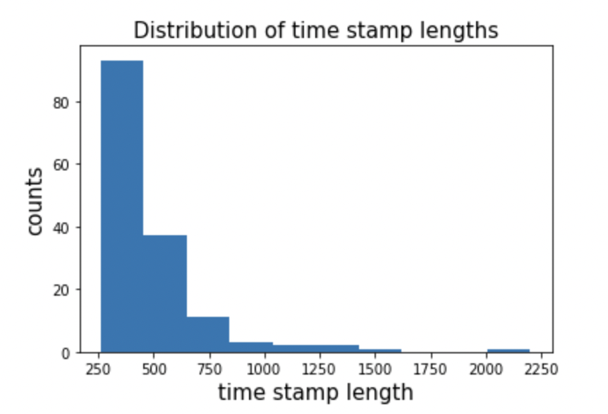
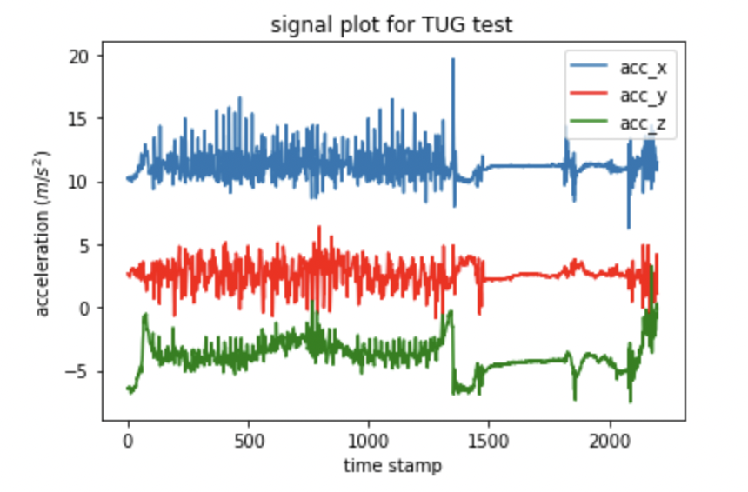
Sampling points

Slide 19
Truncation
$$\left[\begin{aligned}x_{1}^{j} \\ y_{1}^{j} \\ z_{1}^{j}\end{aligned}\right]$$
$$\left[\begin{aligned}x_{2}^{j} \\ y_{2}^{j} \\ z_{2}^{j}\end{aligned}\right]$$
$$\left[\begin{aligned}x_{n}^{j} \\ y_{n}^{j} \\ z_{n}^{j}\end{aligned}\right]$$
……

Slide 20
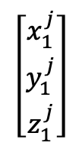
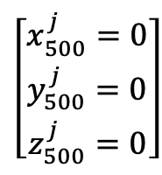
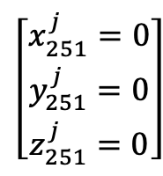
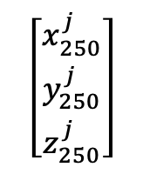
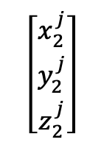
Zero-Padding
Zero padding to timestamp 500
……
$$\left[\begin{aligned}x_{1}^{j} \\ y_{1}^{j} \\ z_{1}^{j}\end{aligned}\right]$$
$$\left[\begin{aligned}x_{2}^{j} \\ y_{2}^{j} \\ z_{2}^{j}\end{aligned}\right]$$
$$\left[\begin{aligned}x_{250}^{j} \\ y_{250}^{j} \\ z_{250}^{j}\end{aligned}\right]$$
$$\left[\begin{aligned}x_{251}^{j}=0 \\ y_{251}^{j}=0 \\ z_{251}^{j}=0\end{aligned}\right]$$
$$\left[\begin{aligned}x_{500}^{j}=0 \\ y_{500}^{j}=0 \\ z_{500}^{j}=0\end{aligned}\right]$$
……

Slide 21
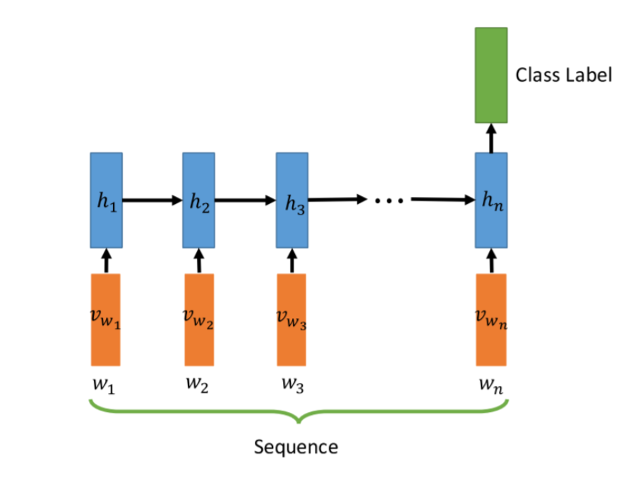
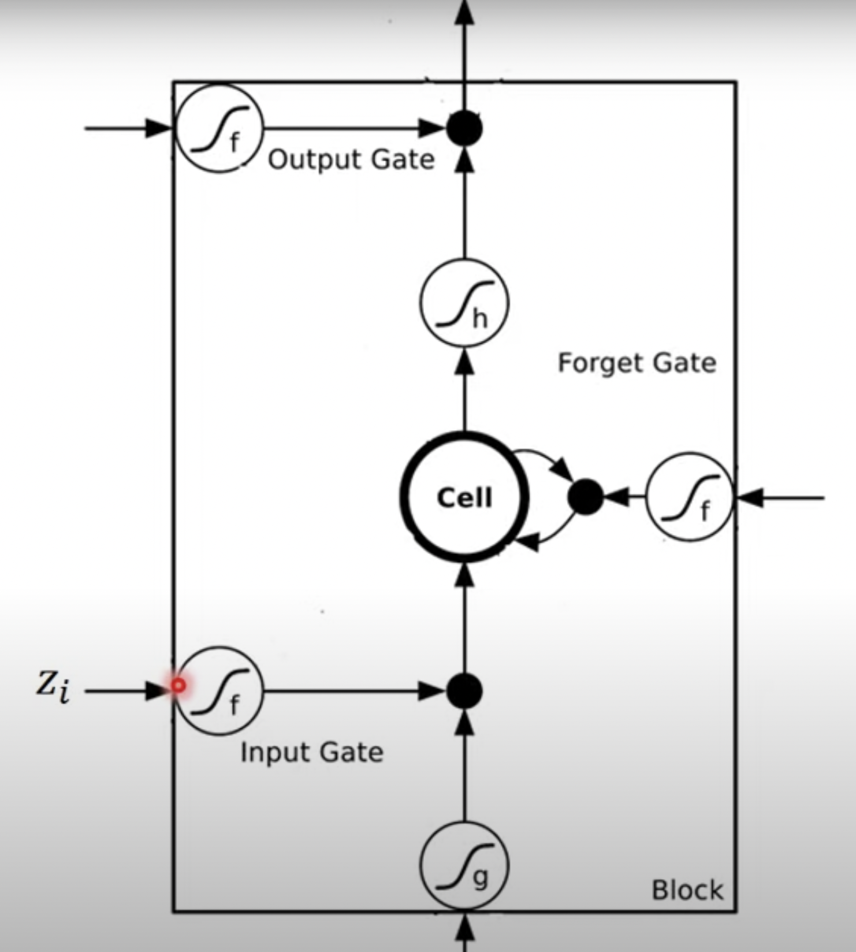
RNN
Sequence = signal
Padding and truncate the sequence to equal length (500 time stamp)
Bi-directional LSTM is used
<Slides from Hung-Yi Lee’s ML course>

Slide 22
Preliminary Results

Slide 23
Preliminary results
<Training>
<Testing>
Accuracy | Precision | Recall
0.8 | 0.8 | 1.0
Accuracy | Precision | Recall
0.8 | 0.8 | 1.0
A\P | 0 | 1
0 | 108 | 0
1 | 27 | 0
A\P | 0 | 1
0 | 12 | 0
1 | 3 | 0
Training : Testing = 90:10 stratified splitting
Potential fallers (1) : non-potential fallers (0) = 30 : 120

Slide 24
Future Works
Try different sampling approach
Bootstrap, leave-one-out
Adjust the structure of the RNN
Add more layers
Tune the sequence length
Implement interpretable feature model

Slide 25
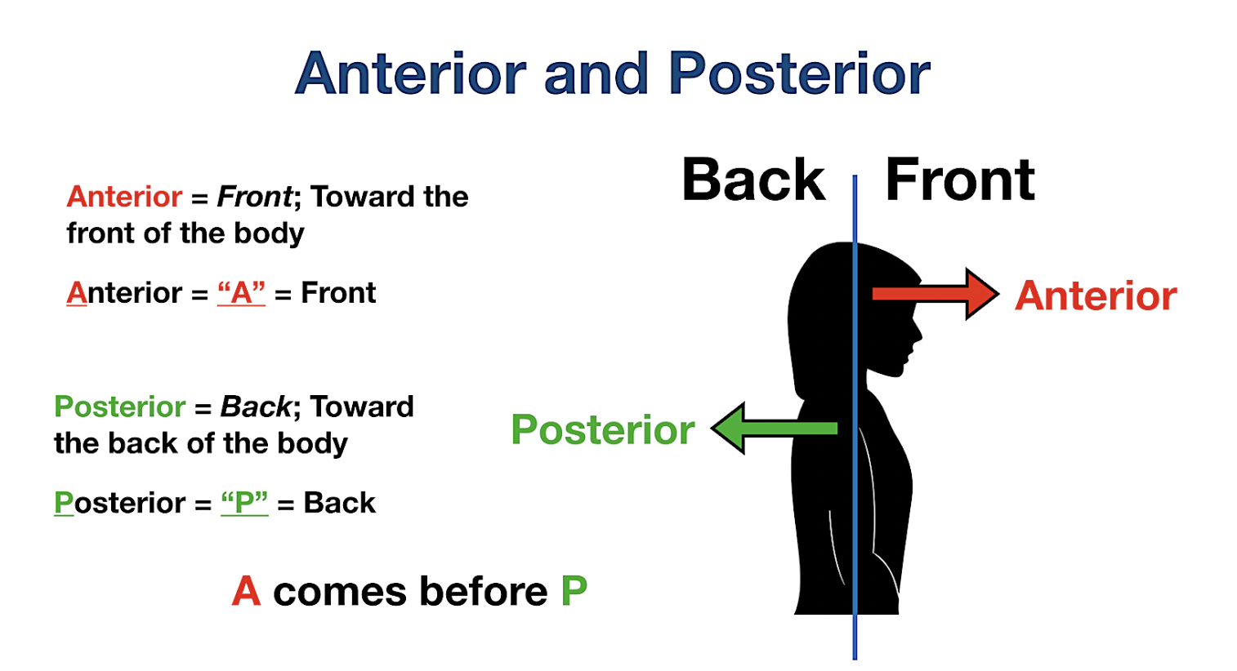
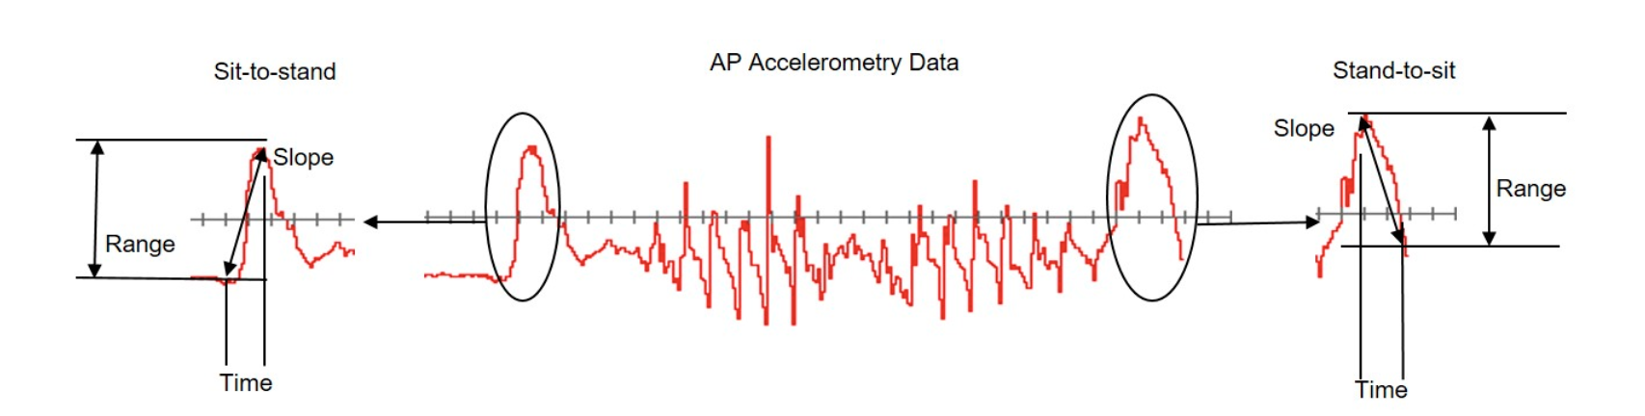
Interpretable Feature based
Features:
Take range, mean, median, slope of acceleration
Take demographic features: age, gender, walking assistant used or not
Model:
Tree model for interpretable features
<Using Wearable Accelerometers in a Community Service Context to Categorize Falling Behavior>

Slide 26

Acknowledgement
Thanks to Prof. Kwok Tsui for advising.
Thanks to Ray Hsu for providing dataset and answering questions from his papers.

Slide 27
References
[1] L. Yu, Y. Zhao, H. Wang, T.-L. Sun, T. E. Murphy, and K.-L. Tsui, “Assessing elderly’s functional balance and mobility via analyzing data from waist-mounted tri-axial wearable accelerometers in timed up and go tests,” BMC Medical Informatics and Decision Making, vol. 21, no. 1, 2021.
[2] W. Villena Gonzales, A. Mobashsher, and A. Abbosh, “The progress of glucose monitoring—a review of invasive to minimally and non-invasive techniques, devices and sensors,” Sensors, vol. 19, no. 4, p. 800, 2019.
[3] P.-H. Lin, S.-C. Sheu, C.-W. Chen, S.-C. Huang, and B.-R. Li, “Wearable hydrogel patch with noninvasive, electrochemical glucose sensor for natural sweat detection,” Talanta, vol. 241, p. 123187, 2022.
[4] K. Dunning, “Timed up and go test,” Encyclopedia of Clinical Neuropsychology, pp. 1–2, 2017.
[5] “Berg balance scale,” Physiopedia. [Online]. Available: https://www.physio-pedia.com/Berg_Balance_Scale. [Accessed: 05-May-2022].
[6] Karthikeyan G, Sheikh S, Chippala P: Test-retest reliability of short form of berg balance scale in elderly people. Glo Adv Res J Med Med Sci 2012, 1(6):139-144.
[7] C.-H. Lee, T.-L. Sun, B. Jiang, and V. Choi, “Using wearable accelerometers in a community service context to categorize falling behavior,” Entropy, vol. 18, no. 7, p. 257, 2016.
[8] A. Sherstinsky, “Fundamentals of Recurrent Neural Network (RNN) and long short-term memory (LSTM) network,” Physica D: Nonlinear Phenomena, vol. 404, p. 132306, 2020.
[9] Y.-C. Hsu, Y. Zhao, K.-H. Huang, Y.-T. Wu, J. Cabrera, T.-L. Sun, and K.-L. Tsui, “A novel approach for fall risk prediction using the inertial sensor data from the timed-up-and-go test in a community setting,” IEEE Sensors Journal, vol. 20, no. 16, pp. 9339–9350, 2020.
[10] Slides adapted from Dr. Hung-yi Lee’s course at National Taiwan

Slide 28

Thank You! Q&A

Slide 29
To-do
Summarize hand-craft features
Visualize the 85 updated subjects’ signal
Sampling technique -> read car accident paper
Construct interpretable features
Literature search on related papers (read Ray’s RNN paper)
Dataset summary (keep on collecting)

